Slide 1
专题
光纤传输系统、光子晶体光纤、纳米光纤

Slide 2
一、光纤传输系统
光孤子、色散管理孤子
光脉冲在光纤中传输时主要受限因素：
损耗、色散和非线性效应．

Slide 3


放大器补偿损耗
Distributed Raman amplifier
EDFA
EDFA , RA , or EDFA + RA

Slide 4
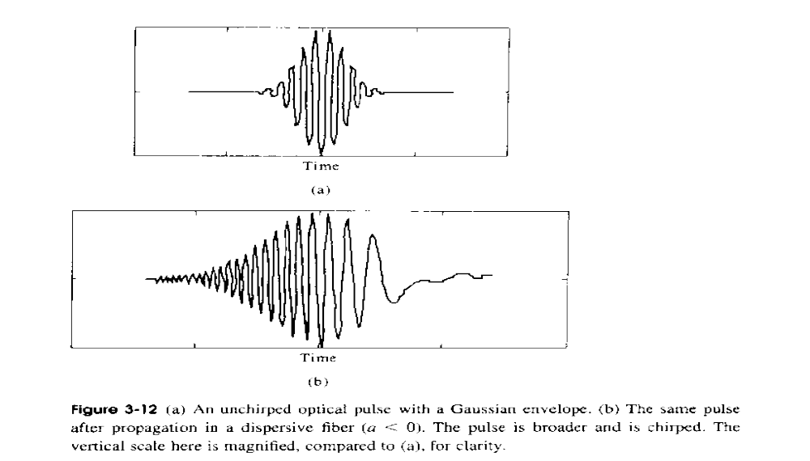
色散导致光脉冲展宽并产生啁啾

Slide 5
非线性效应对光脉冲影响
SPM导致光脉冲频谱展宽
WDM系统中不同信道之间互作用产生四波混频，导致鬼波产生．

Slide 6
信道内 FWM产生 “鬼”脉冲
高色散脉冲在相互交叠的过程中会发生信道内（或信道间）四波混频,引起光脉冲振幅波动,并有可能产生 “鬼”脉冲
amplitude fluctuation
FWM
t
t
t
1
1
0
1
1
1
0
1
Highly dispersed pulses
ghost pulse
Notes:
The forth issue is on intra-channel FWM.
In strongly dispersion managed system, accumulated dispersion becomes large and pulses are highly dispersed.
In such a system, inter-channel and intra-channel XPM, and SPM are greatly suppressed.
However, overlapped tails with strong chirp induce FWM in the time domain.
As a result, amplitudes of pulses are fluctuated and ghost pulses generate.

Slide 7
信道间交叉相位调制 XPM
Collision-induced frequency shift and timing jitter
Feature of collision between pulses in different channel is important.
→ Dispersion management with proper design is effective.
(Cancellation effect is expected.)
XPM
Frequency shift
λ₁
λ₂
t
t
t
& timing jitter
t
t
example 2
λ₂
example 1
λ₂
λ₁
length
λ₁
length
Notes:
The third issue on signal degradation is inter-channel XPM, which causes collision-induced frequency shift and timing jitter of signal pulses.
Paying our attention to the mechanism of this phenomenon, we know that feature of optical path of colliding pulses in fiber is very important.
For suppression of inter-channel XPM effect, dispersion management is also useful if dispersion profile of the transmission line and optical path is properly designed, because some cancellation effects can be expected.

Slide 8
色散参数与非线性效应完美匹配可维持光孤子
适当功率的光脉冲在负色散光纤介质中可保形传输，即光孤子传输．
缺点：按照现在光纤的色散参量，与之匹配的系统光功率很高．

Slide 9
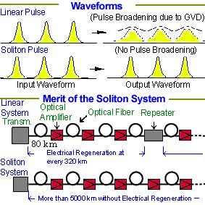

Slide 10
色散补偿技术
1995年提出色散管理孤子方案。光脉冲能量介于线性脉冲和孤子脉冲之间
基本思想： 在光纤线路中连接具有相反色散特性的光纤或元器件对其进行反色散补偿，在适当条件下可使脉冲基本恢复到原来的宽度和波形。
预啁啾技术、频谱反转技术、反色散光纤组成的光纤链、啁啾光纤光栅色散补偿器,光子晶体光纤补偿色散．

Slide 11
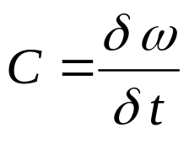
1. 预啁啾色散补偿技术
色散导致频率啁啾：
通过外腔调制，使光源发出的光脉冲带啁啾，与后面光纤色散所致啁啾相反，可起到抑制色散展宽作用。初啁啾要与脉冲宽度、光纤长度、光纤色散等参数精确匹配。

Slide 12
2. 频谱反转技术实现色散补偿
相位共轭器

Slide 13
3. 啁啾光纤光栅色散补偿原理
低频光
高频光
Chirped-FBG

Slide 14
4 . 色散管理光纤链
(Dispersion-managed Fiber Links)
D+ fiber
D− fiber
Accumulated dispersion
Length

Slide 15
小结
光放大器补偿光纤中的损耗．
光纤孤子实现了保形传输．
色散管理孤子是由孤子演化而来的一种呼吸式的稳定传输方式，脉冲功率较小，适合ＷＤＭ光网系统．

Slide 16
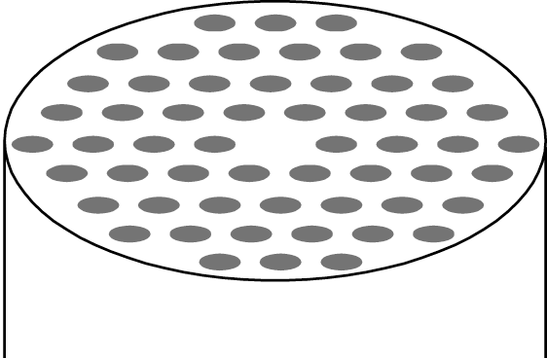
二、光子晶体光纤
（Photonic Crystal Fiber, PCF)
PCF 定义：
中心缺陷和沿光纤轴线呈周期性结构分布的空气孔的二维周期性介电结构．
PCF导光机理：
（１）全内反射原理 (TIR)
（２）光子带隙 (PBG)
Central Defect
Λ
Air hole (d)
Silica glass

Slide 17
Section of PCF
holes
Defect
TIR PCF
PBG PCF

Slide 18
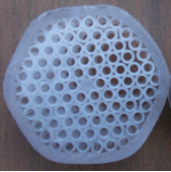
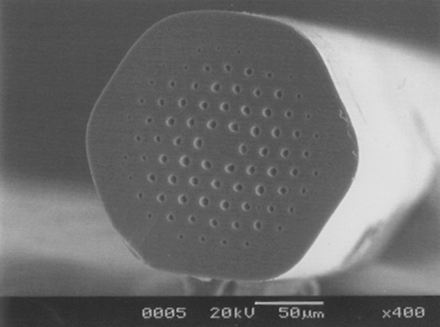
Preform picture
SEM image

Slide 19

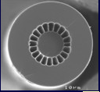
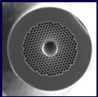
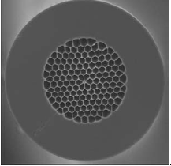
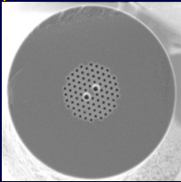

Slide 20
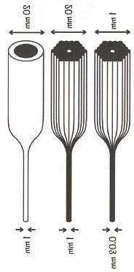
PCF 制备工艺
玻璃毛细管聚束熔拉法
20 mm
20 mm
1 mm
30 mm
16 mm
0.8 mm
Solid rod
Hollow tube
1 mm
1 mm
0.03 mm

Slide 21
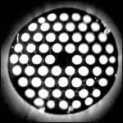
PCF 类型-折射率导引光纤
晶格：三角空气柱包层＋Silica柱芯
原理：低等效包层折射率－全内反射
特性：次高阶模截止带宽内单模传输

Slide 22
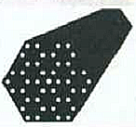
PCF 类型-光子带隙导引光纤
晶格：六角空气柱包层＋空气柱芯
原理：光子带隙限制局域单模传输
特性：带隙窗口(数μm)内单模传输
空气柱芯

Slide 23
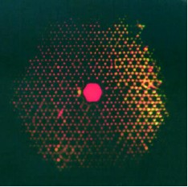
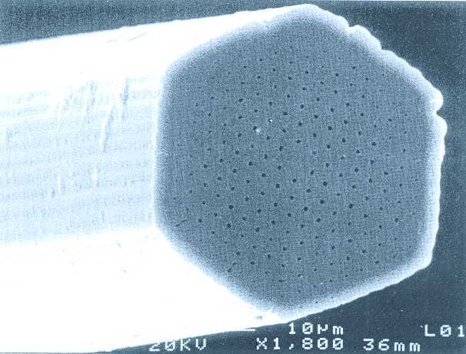
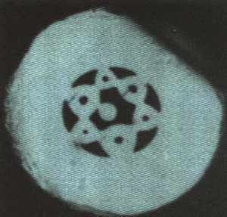
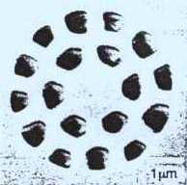
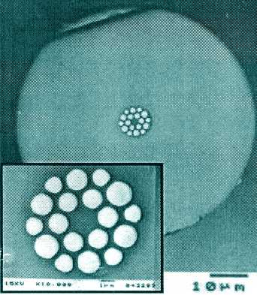
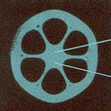
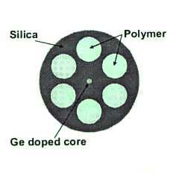
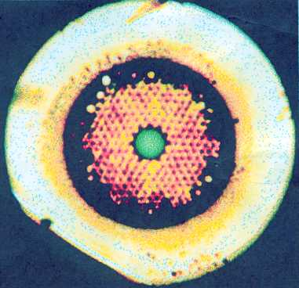

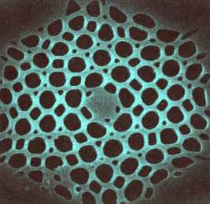
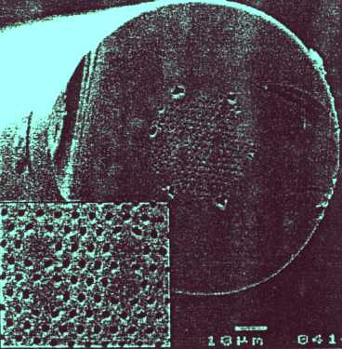
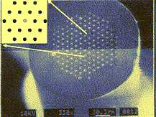
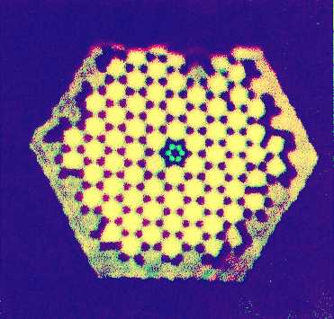
光子晶体光纤
(PCF)
GLS glass
Polymer

Slide 24
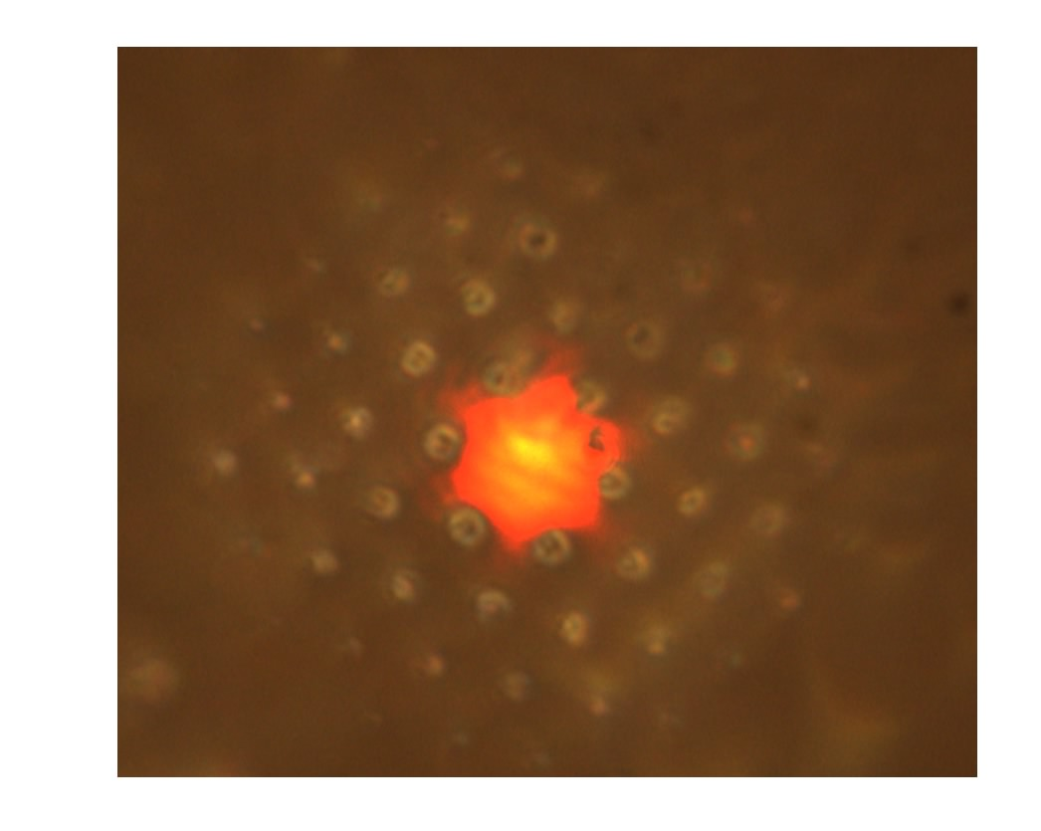
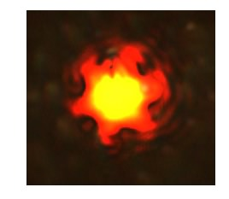
Field Distribution

Slide 25
光子晶体光纤的最诱人特性有：
★ 宽带单模
★ 色散特性易控．
★ 模场面积易控，可实现很小或很大非线性效应．
★ 很小弯曲损耗．
★ 空气纤芯传输可完全消除色散、非线性效应和损耗．
★ 双折射效应

Slide 26
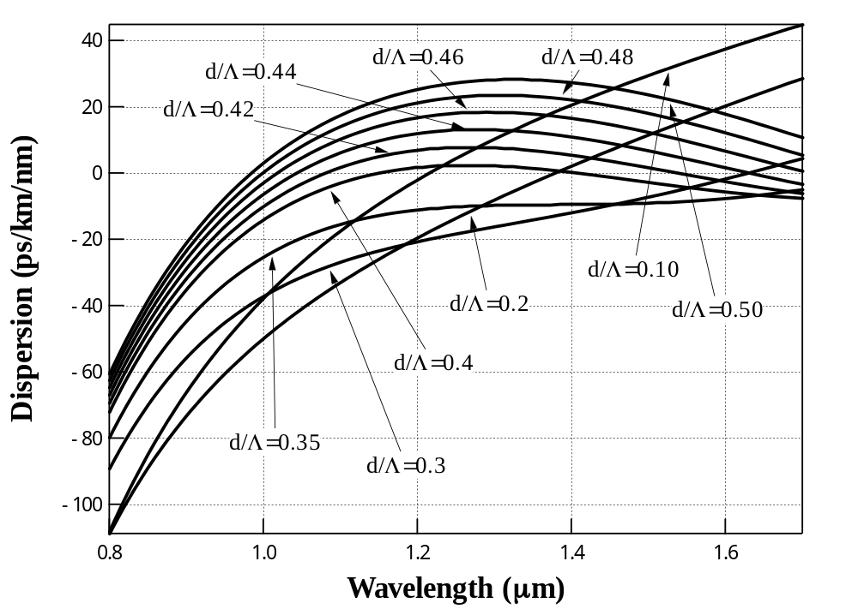
Dispersion Properties
Λ(=2μm) is fixed
d
Λ

Slide 27
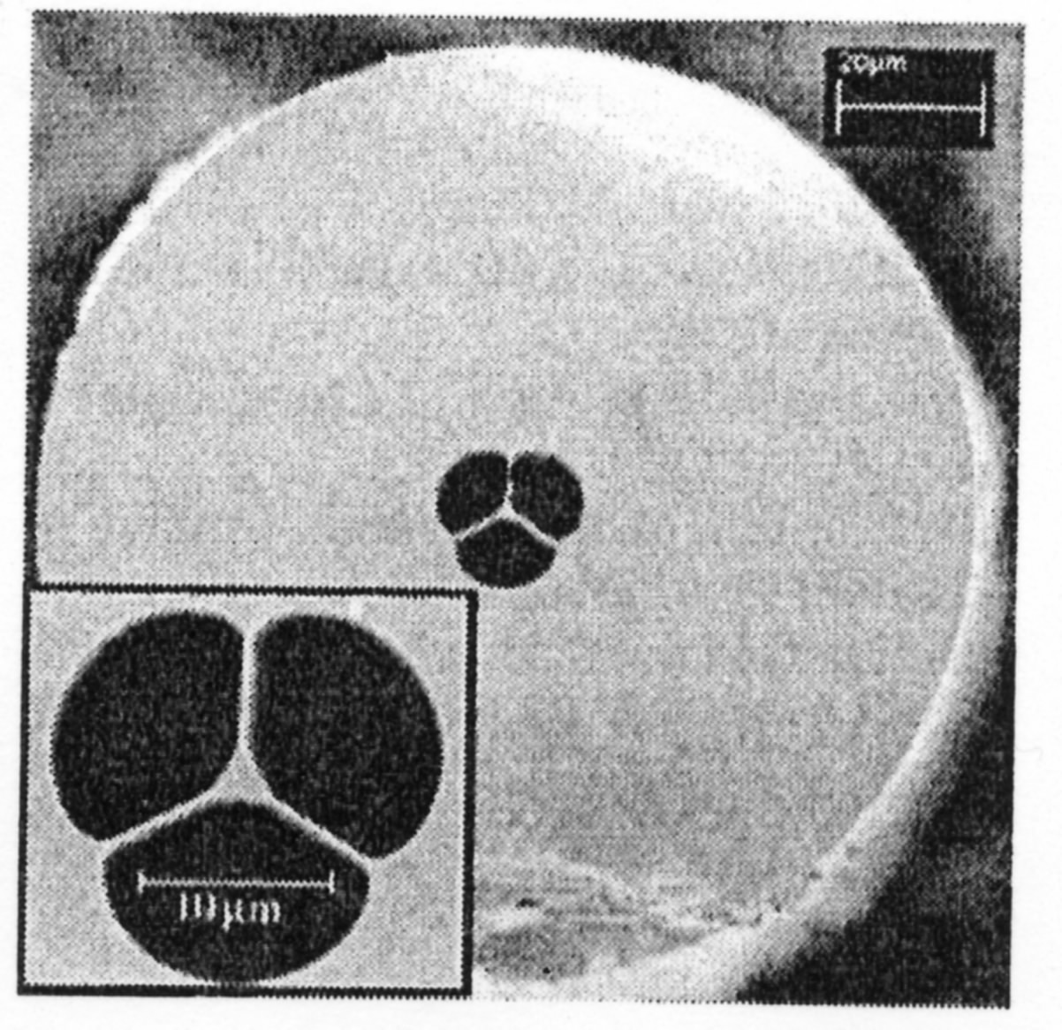
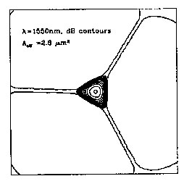
High-nonlinear PCF
Extrusion technique
Lead silica glass
High nonlinear coefficient
640W⁻¹km⁻¹@1550nm
Small Aeff
2.6μm²@1550nm
High nonlinear index
4.1x10⁻¹⁹m²/W@1060nm

Slide 28
光子晶体光纤的应用预测
★色散补偿（大色散）
★非线性介质（小模场面积）
★密绕光纤系统、转弯器件（弯曲损耗很小，Ｒ～3mm,几乎无弯曲损耗)．
★偏振相关器件（强双折射效应）．

Slide 29
光通信方面的应用
高功率光的光纤传输 色散补偿
白光源 波长变换器
空心传输光纤 多芯光纤偶合器
脉冲成型器 长时间作用的化学传感器
温敏的PM尾纤 单模连接用高Aeff和PM光纤
模变换器
陀螺仪光纤——无热、高双折射型压力和温度传感器

Slide 30
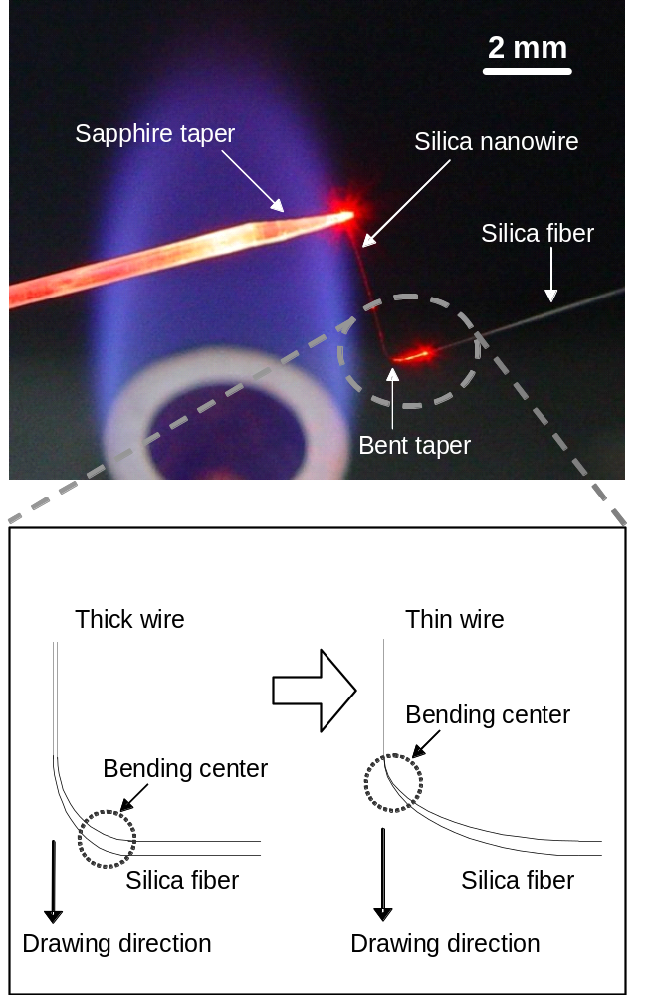
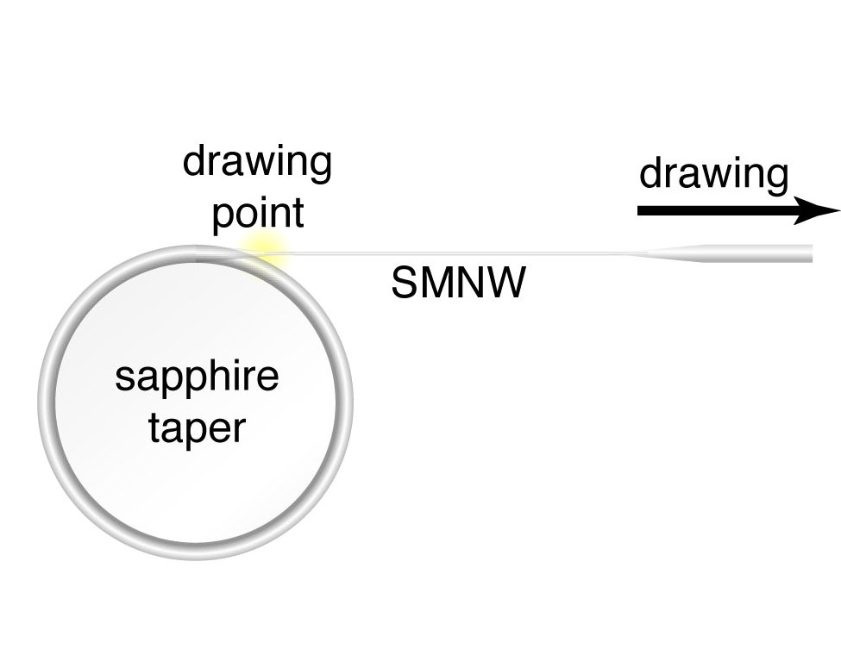
三、纳米光纤 Nanofibers
Explore the Nature and Science of Light
制备 Fabrication
高温拉伸法
High-temperature taper drawing method
Self-modulated → 20 nm
2-step → 50 nm
L. Tong et al., Nature 426, 816-819 (2003).
L. Tong et al., Nanotechnology 16, 1445–1448 (2005).

Slide 31
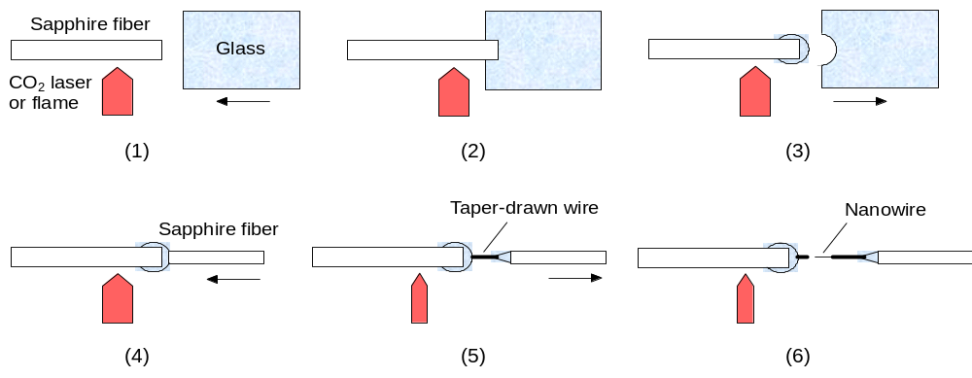
纳米光纤 Nanofibers
Explore the Nature and Science of Light
制备 Fabrication
玻璃直接拉伸
L. Tong et al., Opt. Express 14, 82 (2006).

Slide 32
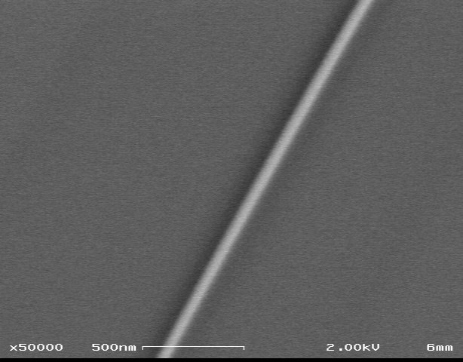
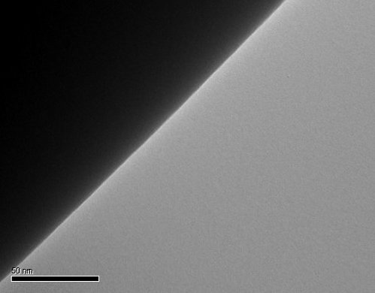
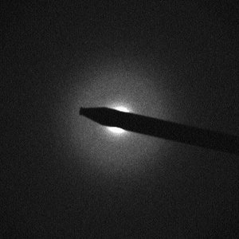
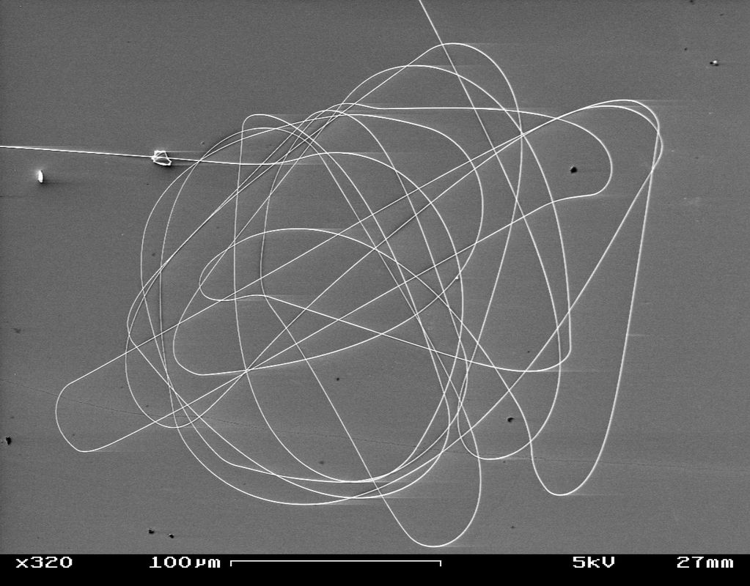
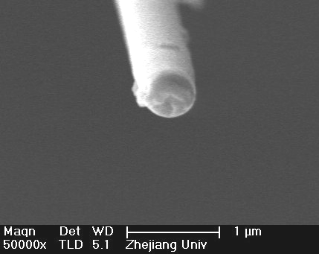
纳米光纤 Nanofibers
Explore the Nature and Science of Light
形貌
Geometrics
D = 50 nm
D = 240 nm
Uniform diameter
Smooth sidewall
SEM / TEM images
OPN, April 2004
D = 260 nm
D = 480 nm
Circular cross section
Large length
Nature 426, 816 (2003)

Slide 33
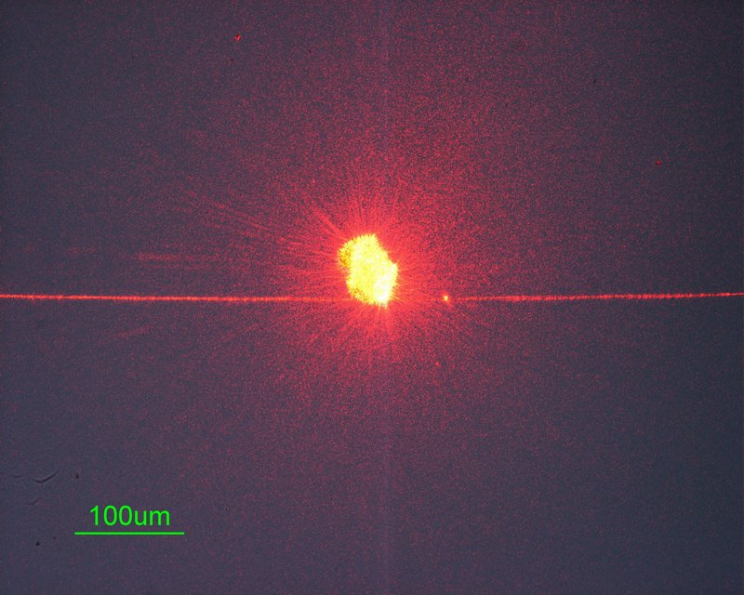
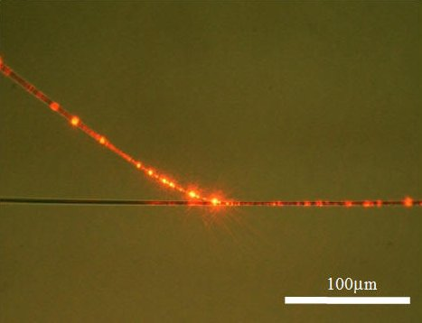
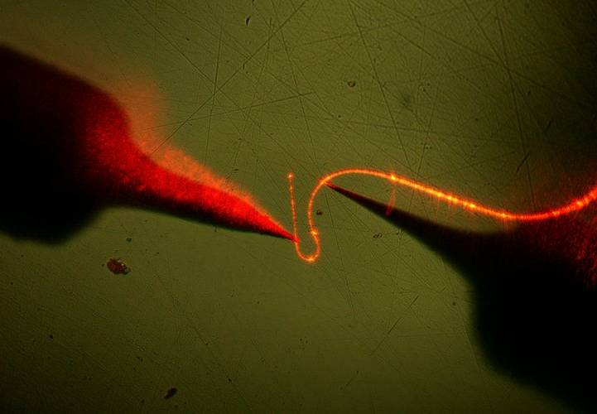
纳米光纤 Nanofibers
Explore the Nature and Science of Light
光传输与损耗
Optical guiding and loss
Scattering v.s. guided intensity
Light launching using evanescent coupling
Light guided through a sharp bend
L. Tong et al., Nature 426, 816-819 (2003).

Slide 34
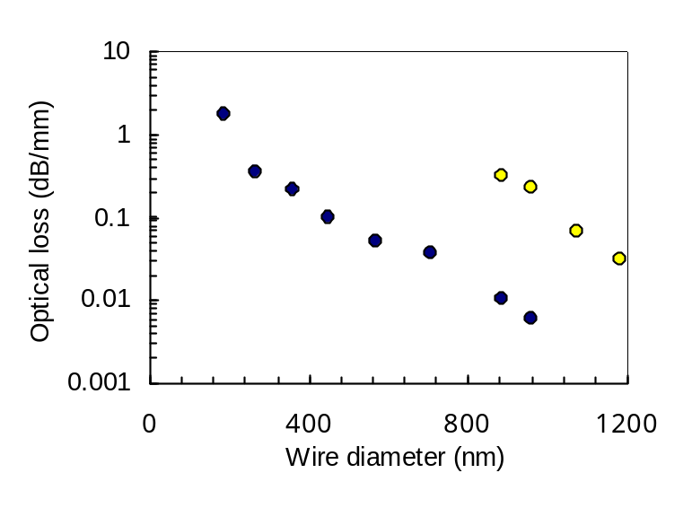
纳米光纤 Nanofibers
Explore the Nature and Science of Light
光学损耗 Optical loss
单模传输损耗
December 2003: α < 0.1 dB/mm
May 2004: α < 0.01dB/mm
G. Brambilla et al., Opt. Express 12, 2258-2263 (2004).
June 2004: α < 0.001dB/mm
S. G. Leon-Saval et al, Opt. Express 12, 2864–2869 (2004).
L. Tong et al., Nature 426, 816-819 (2003).
Someday: α < 0.0001dB/mm ?

Slide 35
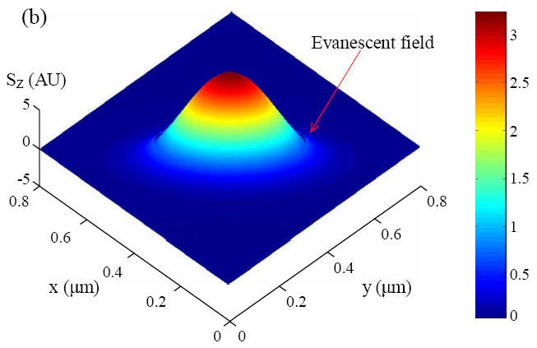
纳米光纤 Nanofibers
Explore the Nature and Science of Light
光学传输特性 Optical guiding properties
强场约束 Tight optical confinement
1
D=1600nm
0.8
D=1200nm
D=800nm
D=400nm
0.6
D=100nm
(Normalized Unit)
0.4
e
r
0.2
ε
D=200nm
0
0.5
1
D=100nm
1.5
r
(
μ
m)
The radial component of electric field
(f(
φ
)=
1
,
λ
=63
3
nm)
L. Tong et al., Opt. Express 12,1025-1035 (2004).
J. Lou et al., Opt. Express 13, 2135–2140 (2005).
Applications
Size miniaturization, high-density optical integration …

Slide 36
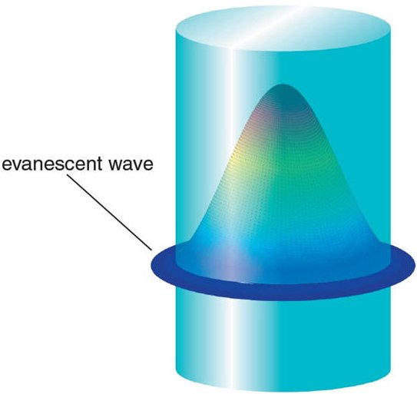
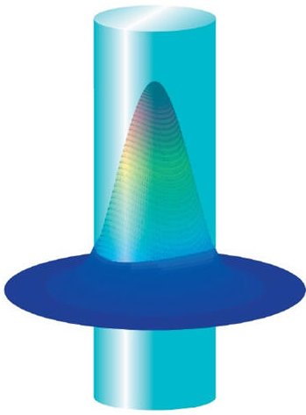
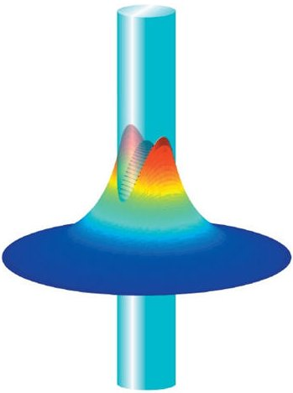
纳米光纤 Nanofibers
Explore the Nature and Science of Light
光学传输特性 Optical guiding properties
倏逝波传输 Evanescent wave guiding
Applications
Optical sensing, optical coupling, atom trapping …

Slide 37
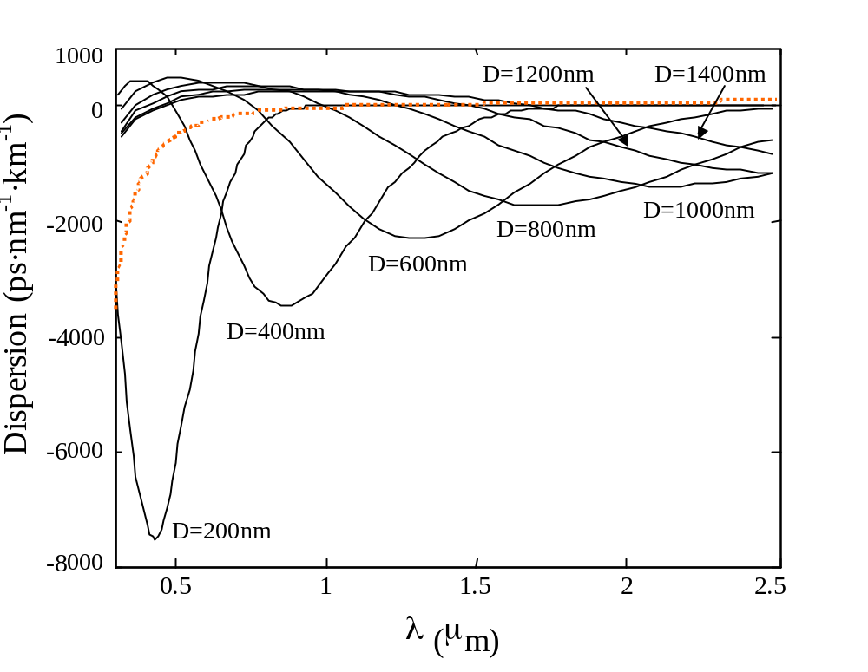
纳米光纤 Nanofibers
Explore the Nature and Science of Light
光学传输特性 Optical guiding properties
波导色散 Waveguide dispersion
Applications
Dispersion shifting, nonlinear effects …
L. Tong et al., Opt. Express 12,1025-1035 (2004).

Slide 38
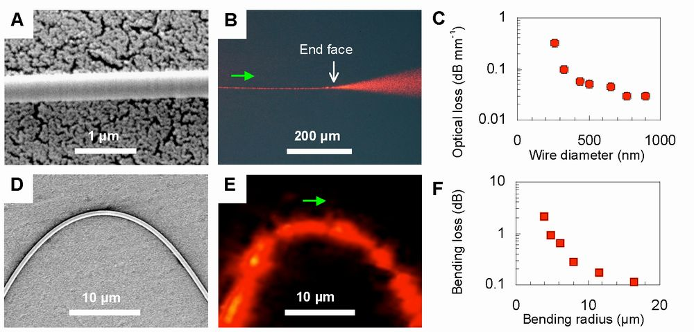
纳米光纤 Nanofibers
Explore the Nature and Science of Light
光集成 Nanoscale photonic integration
Silica aerogel supported silica nanowires
L. Tong et al., Nano Lett. 5, 259 (2005)

Slide 39
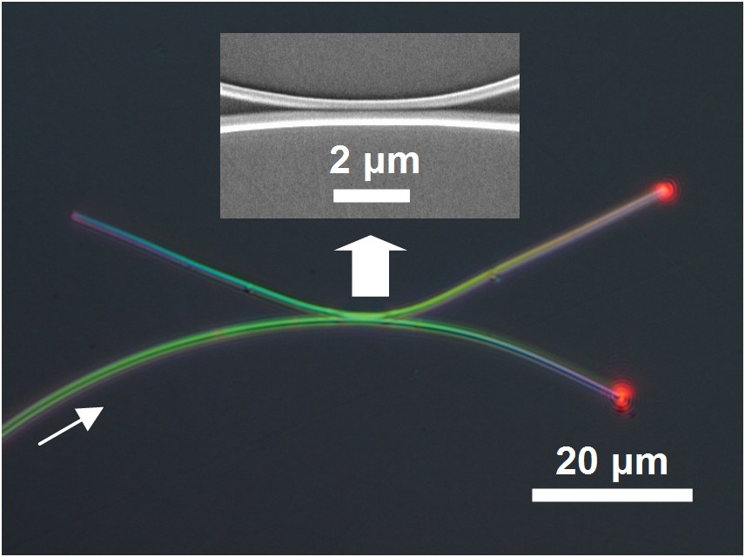
纳米光纤 Nanofibers
Explore the Nature and Science of Light
光子器件 Photonic Nanowire Devices
光波耦合器 碲酸盐玻璃光纤+石英玻璃衬底
Microcoupler assembled with tellurite fibers
Fiber diameter：350&450 nm
Wavelength：633 nm
Transfer length：＜5 μm
Substrate: Silica
No excessive loss!
3-dB splitter
L. Tong et al., Opt. Express 14, 82 (2006).

Slide 40
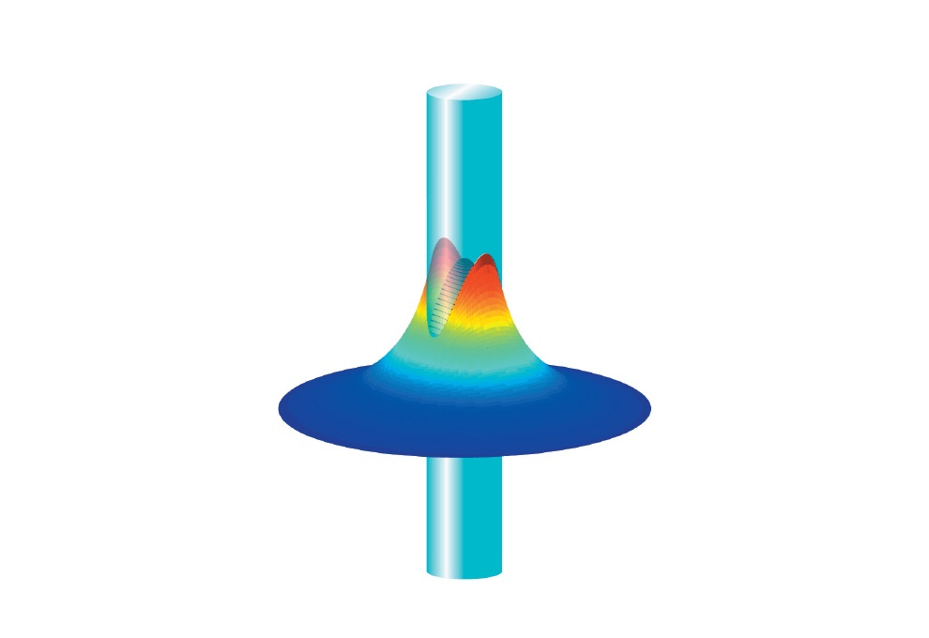
纳米光纤 Nanofibers
Explore the Nature and Science of Light
光子器件 Photonic Nanowire Devices
光学传感器 Optical sensors
散射
吸收
发光
可检测物理量：
(1) 强度
(2) 相位
(3) 光谱

Slide 41

纳米光纤 Nanofibers
Explore the Nature and Science of Light
光子器件 Photonic Nanowire Devices
光学传感器 Optical sensors
Phase detection scheme
J. Lou et al., Opt. Express 13, 2135–2140 (2005).

Slide 42


纳米光纤 Nanofibers
Explore the Nature and Science of Light
光子器件 Photonic Nanowire Devices
环形谐振腔 Loop resonators —— OFS Laboratory (USA)
M. Sumetsky, Appl. Phys. Lett. 86, 161108 (2005).

Slide 43

纳米光纤 Nanofibers
Explore the Nature and Science of Light
其他应用
超连续光谱 Supercontinuum generation —— University of Bath (UK)
S. G. Leon-Saval et al., Opt. Express 12, 2864 (2004).

Slide 44


